Slide 1

Group 5:
Predicting Mortality of Pulmonary Embolism Patients in the ICU
8.18.23
Data Scientist: Nikolaj Munch Andersen
Students: Sung Hae Chang, Sarah Loh, Heena Manglani & Rachel Rosen

Slide 2
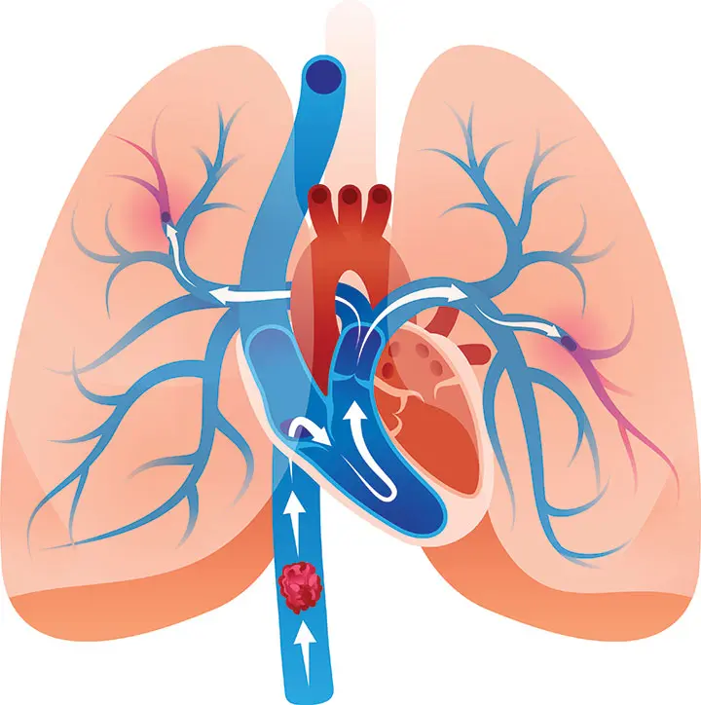
Problem
Pulmonary embolism (PE) is a clot within the pulmonary arteries which prevents blood flow in the lungs.
PE has a high 30-day mortality rate (Yamomoto, 2018)
Identifying risk factors of mortality would signal who is at critical need for timely treatment.
Question: What are the predictors of mortality in patients diagnosed with PE who are admitted to the ICU?
Notes:
- Problem definition: Specifically, how would the model improve patient outcomes?
The incidence of PE is estimated to be approximately 60 to 70 per 100,000, and that of venous thrombosis approximately 124 per 100,000 of the general population (Exp Clin Cardiol. 2013 Spring; 18(2): 129–138 Exp Clin Cardiol. 2013 Spring; 18(2): 129–138.)
The 30-day mortality rate of patients with PE who develop shock ranges from 16 to 25% and that of patients with cardiac arrest ranges from 52 to 65% .
Comparing this model and known risk factors, we can validate known factors & identify potential new factors.

Slide 3
Database & Inclusion/Exclusion Criteria
Database: MIMIC-IV ICU module, clinical data derived from MetaVision clinical information system
Final Cohort = 1,743 patients in the ICU
Inclusion Criteria:
Patients admitted to any ICU during a hospital stay at BIDMC between 2008-2019
Exclusion Criteria:
Patients who did not have an ICU stay
Patients who did not have ICD-10 code of I26 (i.e., pulmonary embolism) or ICD-9 code of 415.1 (i.e., pulmonary embolism and infarction)
Patients <18 years old
Identified as a patient requiring enhanced protection
Notes:
- What database are you going to use? Please identify potential issues with the database. How did patients get into the database? Who got excluded?
- Inclusion and exclusion criteria: Consider sampling selection bias that can seep into the study design as a result of these criteria.

Slide 4
Model Features
Technique: gradient boosting trees
Demographics
Age
Sex
Race
Insurance status
Prior Comorbidities
Congestive heart failure
Diabetes
Hypertension
History of DVT
History of MI
History of cancer
History of Factor 5 Leiden
In-Hospital Values
Vitals: SpO2, HR, RR, BP, temperature
Ventilation status
Lab values: (max, min, avg)
ABG
Creatinine
Hemoglobin
INR/PT/PTT
Glucose
Lactate
Urine output
Pressor requirements
Notes:
- List of features and their definition: Consider bias with the use of these features and their definition.
No data on smokers which could be a big predictor of outcome
Not able to include surgical data such as pulmonary thrombectomy/thrombolysis, which affects mortality outcomes.

Slide 5
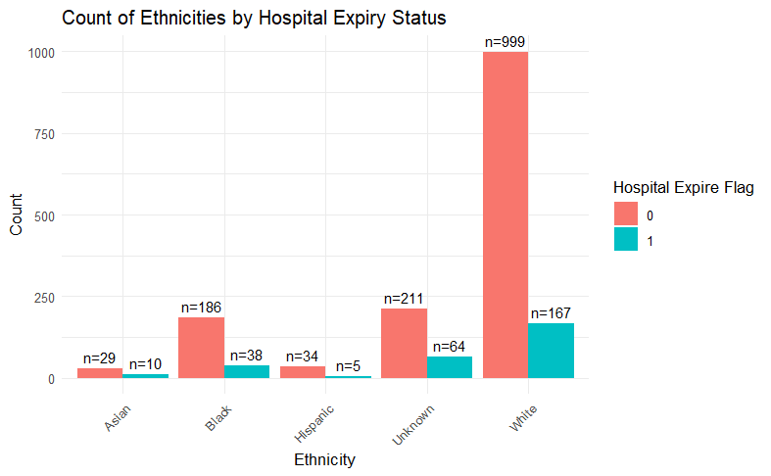
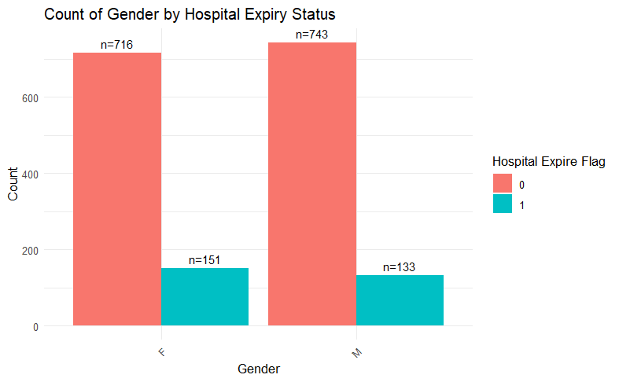
Model Features
Distribution of Demographics:

Slide 6
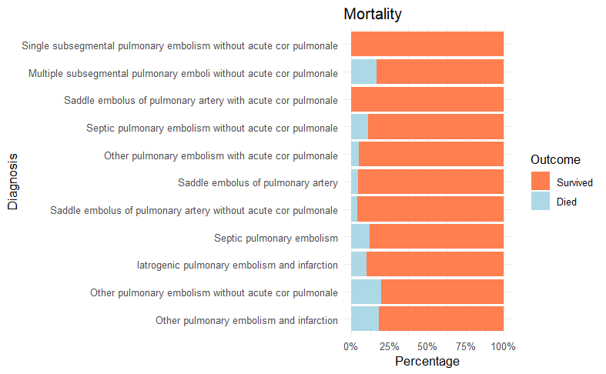
Model Features
Limitations:
No data on smokers
Not able to include surgical data such as pulmonary thrombectomy/thrombolysis
Unable to collect baseline values (values prior to ICU admission) – could underestimate the true change from baseline status
Aggregate values for labs/vitals may not accurately reflect the trends over hospital stay
Inclusion based on the general ICD 9 and ICD 10 codes, may not be generalizable for specific sub-categories of the diagnosis
Notes:
- List of features and their definition: Consider bias with the use of these features and their definition.
No data on smokers which could be a big predictor of outcome
Not able to include surgical data such as pulmonary thrombectomy/thrombolysis, which affects mortality outcomes.

Slide 7
Model Outcomes
Event of interest: Mortality from PE
→ Total: 184 deaths
→ Assess if there are differences in outcomes based on race and socioeconomic factors
Limitations:
Model only applies to ICU patients
Assumes mortality was due to PE, but specific cause of death was not included in the model
Notes:
- Outcome or event of interest: How is this defined? Consider bias in how the outcome or the event of interest is defined.

Slide 8
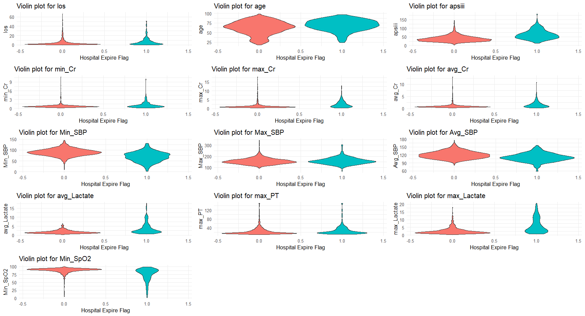
1 = Expired

Slide 9
Bias
Sources of bias
Predominantly White sample (66.8%)
Potential misclassification by ICD codes
Differences in likelihood of tests/treatments
Provider bias in decision-making
Variation in frequency of measurements and monitoring
Medical devices work differently in some populations
Ex: SPO₂ based on skin tone
Trade-off: Selection bias vs. missing data
Selection bias: only including ICU records
Less missing data: only including ICU data to avoid missing data
Notes:
Trade-off
Missing data - data is collected more regularly in the ICU
Most severe patients not included: Patients who died in the ED or during procedure prior to admission to ICU will be excluded from the cohort → this may reflect a selection bias in which the more sick patients are not included in the analysis
Least severe patients not included: Patients who were admitted to non-ICU service or discharged home will be excluded from the cohort → this may reflect a bias in which much healthier patients are not included in the analysis
Limitations in generalizability: results can
- Evaluation of in silico model performance How will the model be incorporated in practice? Any unintended consequence of the algorithm when employed.

Slide 10

Thank you!

Slide 11
SQL Query – Prediction Model for Mortality in patients with Pulmonary Embolism in the ICU
Patients with an ICU dx of Pulmonary Embolism
ICD 10: I26
ICD-9: 415.1
Variables:
Demographics (age, sex, education, race, ethnicity, English proficiency, Insurance)
Comorbidities: cancer, deep vein thrombosis, recent surgery (within 30-days), antiphospholipid antibody syndrome, arrhythmia, heart failure, factor 5 leiden
Vitals (RR; HR; SBP; DBP; MAP; SpO2)
Labs (coagulation factors, ABG, SaO2, LDH, D-Dimer, Hb, CRP, Cr, BNP)
ECHO data
EKG data
Procedures (thrombolysis, thrombectomy)
Behavioral health indicators: smoking, exercise
Anticoagulation data (prior AC and anticoagulation given during hospitalization)
Data on vasopressors (epinephrine, neosynephrine, vasopressin, levophed)
Data on mechanical ventilation

